Slide 1

WEL-COME TO ALL

Slide 2


SWAPAN KUMAR BHOWMIK.
ASSISTANT TEACHER
CHILONIA UNION HIGH SCHOOL.
SENBAG,NOAKHALI.

Slide 3
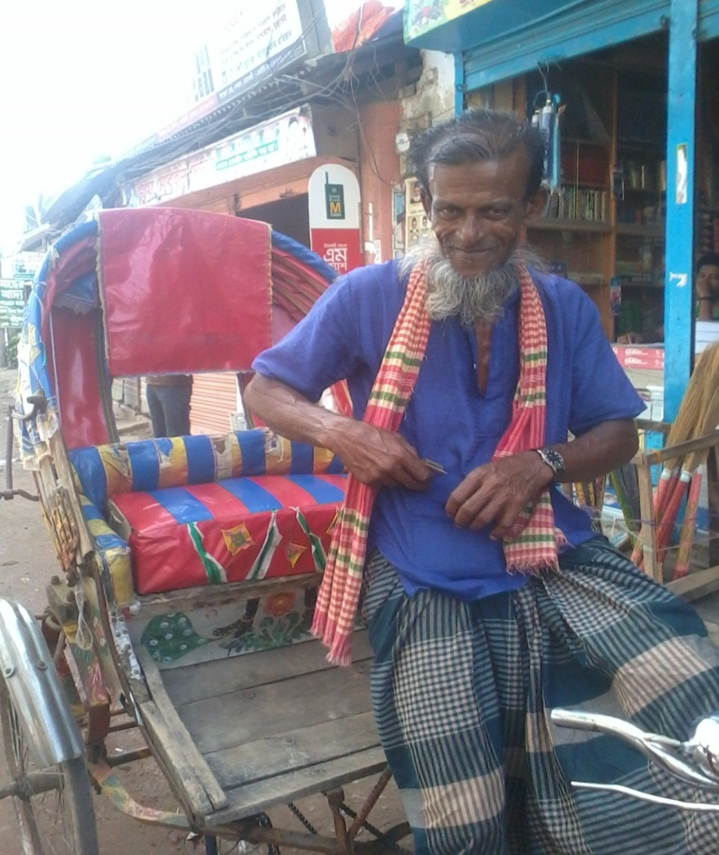
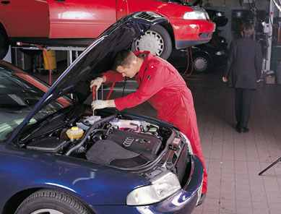
Look at the following pictures and say what are called the men and what do they do?
RICKSHAW PULLER
MECHANIC

Slide 4

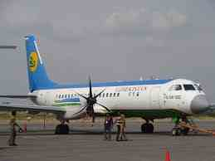
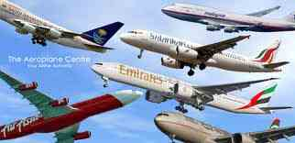
Look at these pictures and say who led these kinds of aircrafts and where are their work place?
Astronauts/ In the Space

Slide 5


CLASS-TEN
ENGLISH 1ST PAPER.
UNIT-EIGHT,LESSON-3.
“SPACE TECHNOLOGY”

Slide 6
Learning Outcomes
By the end of the lesson, learners will be able to -------1.Talk about the pictures related to the topics gradually.
2.Read a biography of Neil Armstrong.
3.Fill up some gaps with information from texts.

Slide 7
Watch the video and gather more knowledge
about space-technology

Slide 8
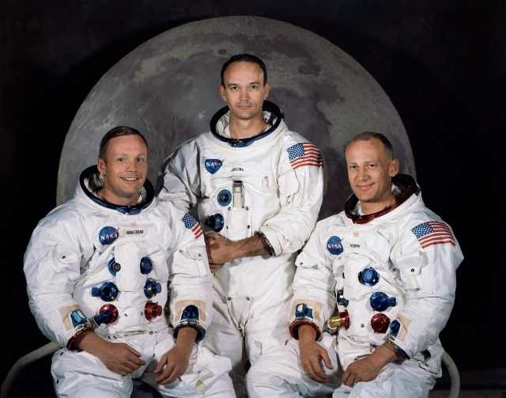
Eminent Astronauts On The Moon
Buzz
Aldrin
Armstrong
Mike Collins

Slide 9
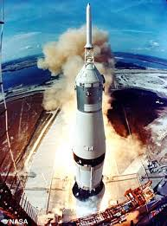
* Do you know the name this space ship?
* Who commanded this?
Apollo 11
Neil Armstrong

Slide 10
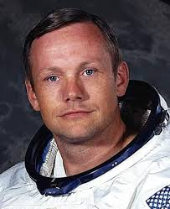
What do the following refer to in the text?
B,sc from pardue university
M,sc from U,S,C
Gather
Moon rocks-20-6-69
August
,5,1930
July 16,1969
Starts for the
Moon by-Apollo-11
J0ined Navy-1949--1952
x-15,Rok-cet plane
[NASA- NACA.1955--Joined.

Slide 11
Group WORK(All group)
Fill up the gaps with correct word from the text.
Neil Armstrong was the first human who(a) on the moon.He (b) at Purdue university.He joined the navy and served there for(c) years.He also worked in the air force as a (d) pilot. The world will (e) forget him.
stepped
studied
four
civilian
never

Slide 12
EVALUATION
1.Who commanded the Gemini 8 mission?
2.Where from Neil Armstrong received M,sc, degree?
3.How many times the astronauts
Stayed on the moon?
4.What did they do on the moon for over two hours?

Slide 13
Home work
Write a short description about
Neil Armstrong within five sentences.

Slide 14

GOOD BYE

